Slide 1
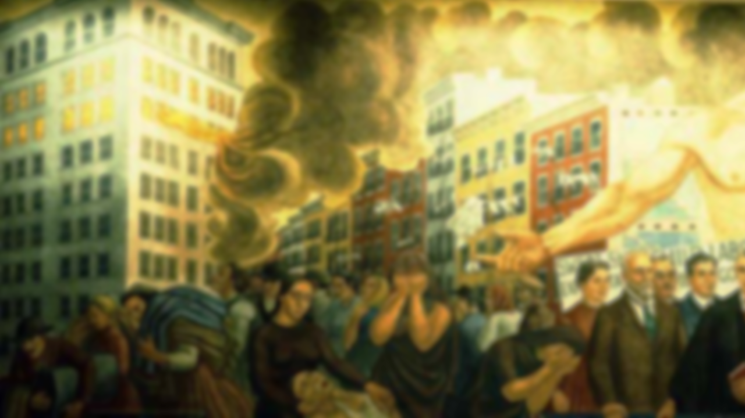

Triangle
Factory Fire

Slide 2
A tragedy that devastated families...
and changed our country.

Slide 3
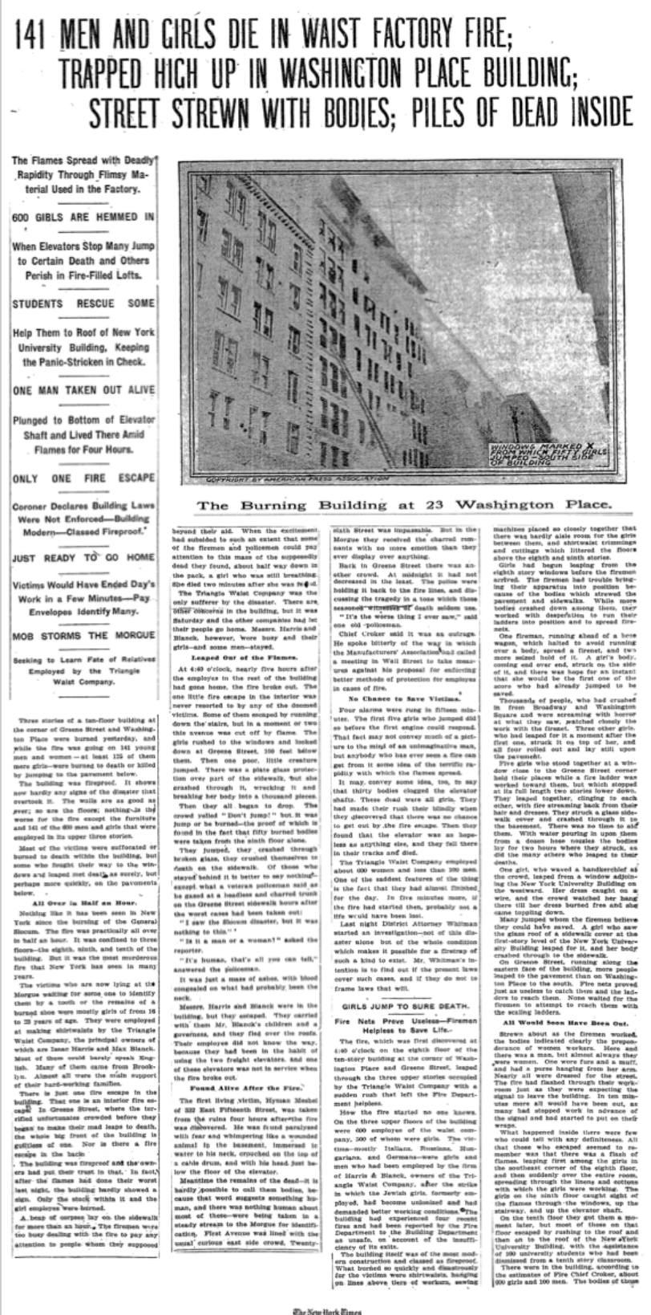

Slide 4

“On the sidewalk lay heaps of broken bodies. A policeman later went about with tags, which he fastened with wires to the wrists of the dead girls, numbering each with a lead pencil, and I saw him fasten tag no. 54 to the wrist of a girl who wore an engagement ring. A fireman who came downstairs from the building told me that there were at least fifty bodies in the big room on the seventh floor. Another fireman told me that more girls had jumped down an air shaft in the rear of the building. I went back there, into the narrow court, and saw a heap of dead girls. . . .”
-William G. Shepard, eyewitness

Slide 5
Background
Notes:
SOCIAL CHANGES
“After the events of the devastating fire, various social changes were put into effect. “

Slide 6
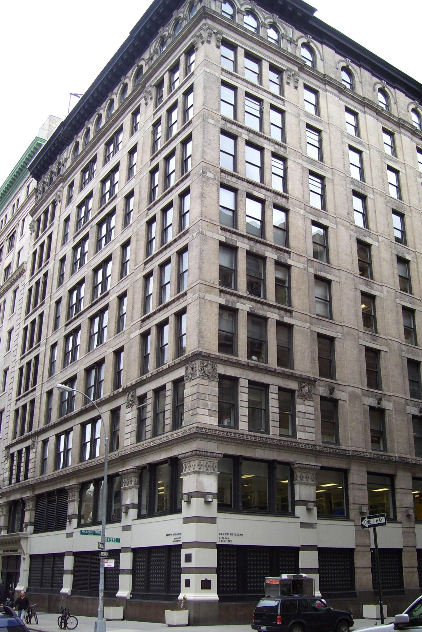
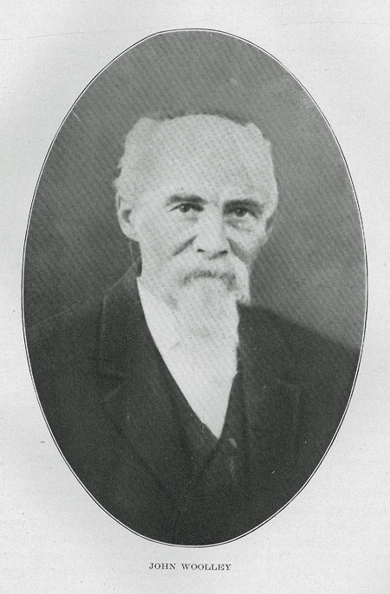
Notes:
“The Asch building was created in 1900 by John Woolley. The Triangle Waist Company factory occupied the eighth, ninth, and tenth floors of the 10-story Asch Building on the northwest corner of Greene Street and Washington Place, just east of Washington Square Park, in the Greenwich Village area of New York City. “

Slide 7
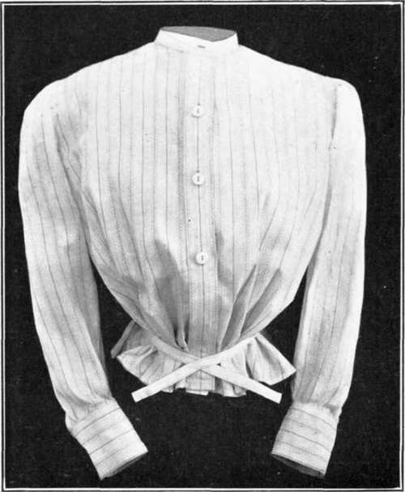
Notes:
“The factory produced women’s blouses, known as “shirtwaists” under the ownership of Max Blanck and Isaac Harris.”

Slide 8
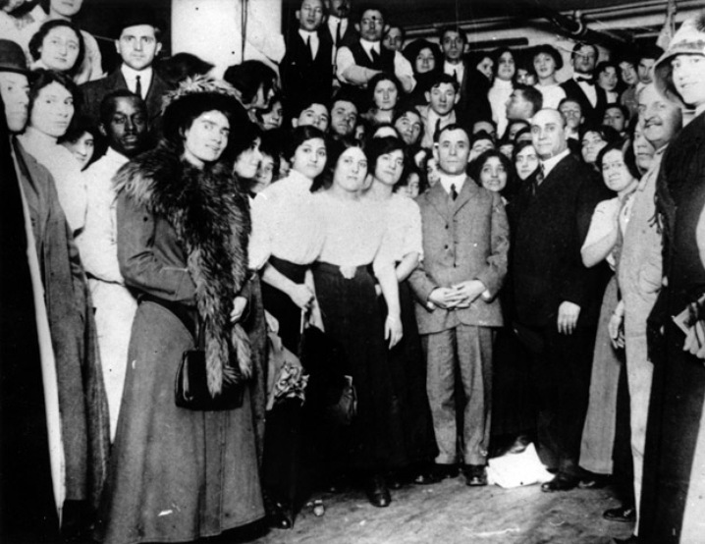
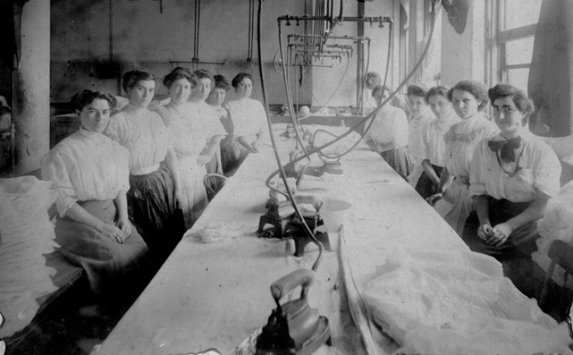
Notes:
“Most workers were female immigrants whose ages ranged from 15-23. The average pay was $6 dollars a week on a 6 day week working cycle while working in often crowded conditions.”

Slide 9
The Fire
Notes:
(burn OLE plug-in)

Slide 10

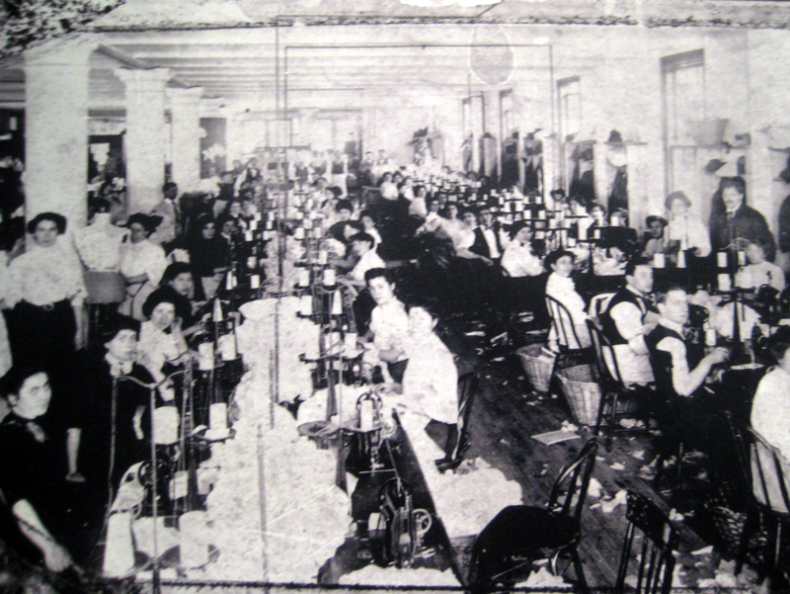
Notes:
“On Saturday, March 25, 1911 it was an average day at closing time. “

Slide 11
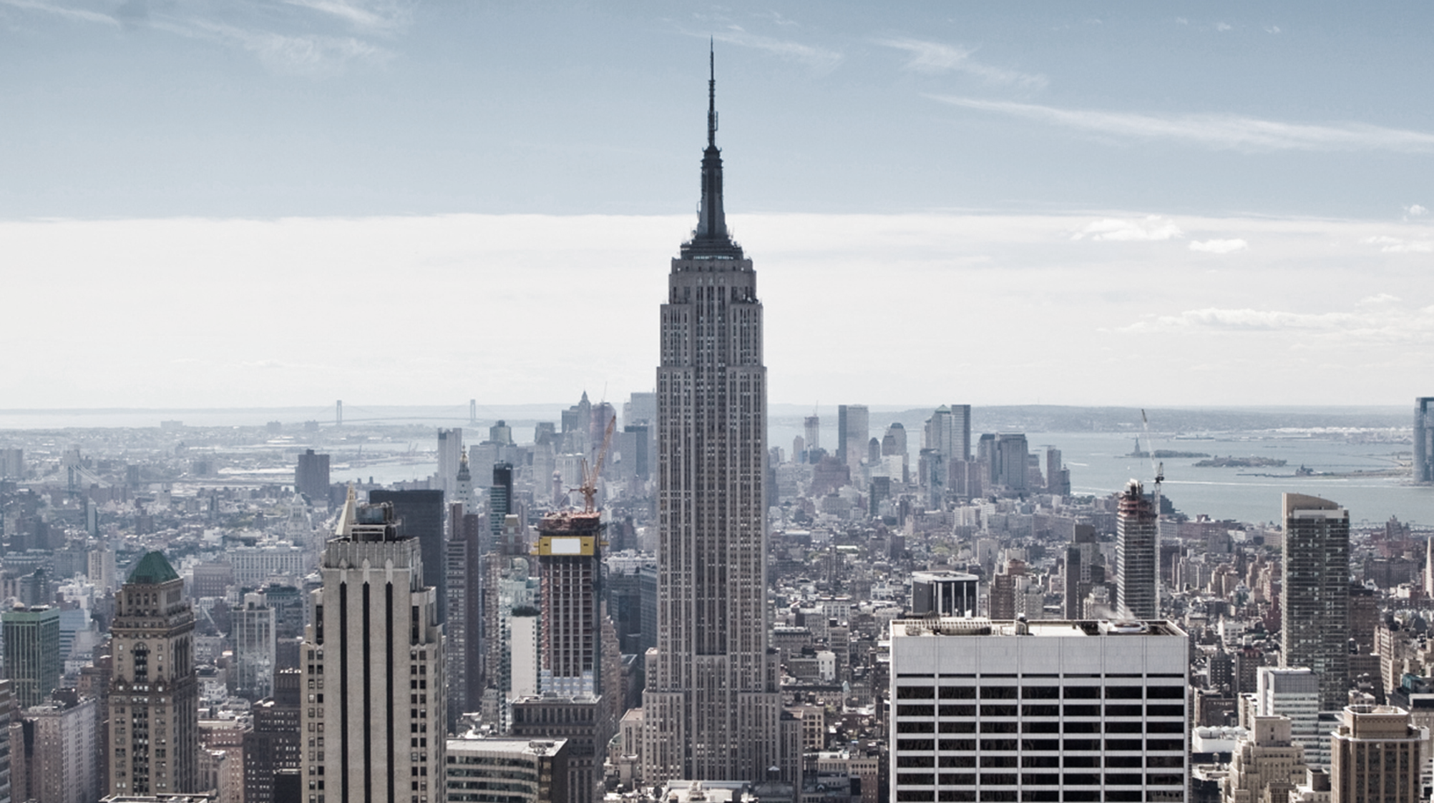



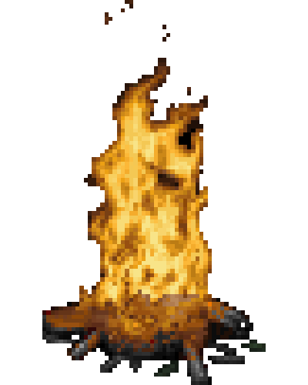
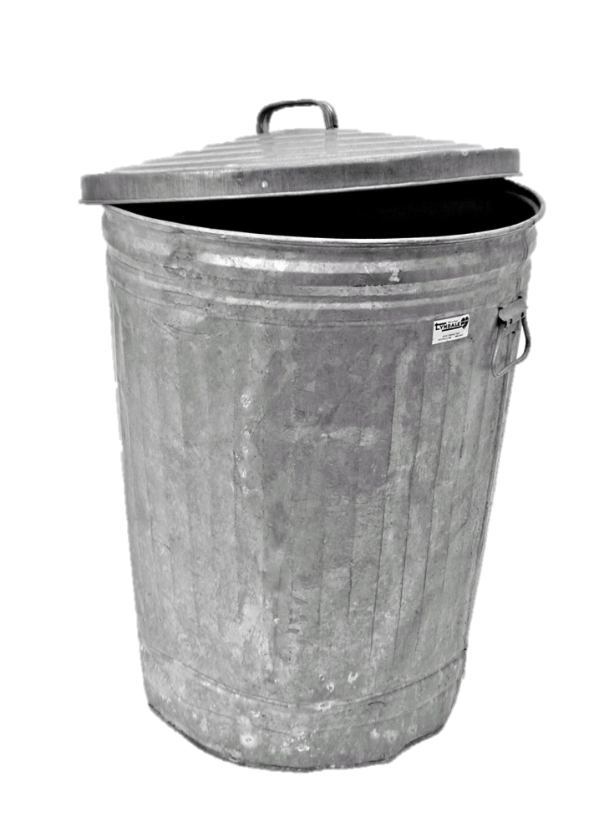
Notes:
“At around 4:40PM a fire sparked in a trash can under one of the cutter's tables at the northeast corner of the eighth floor. “

Slide 12
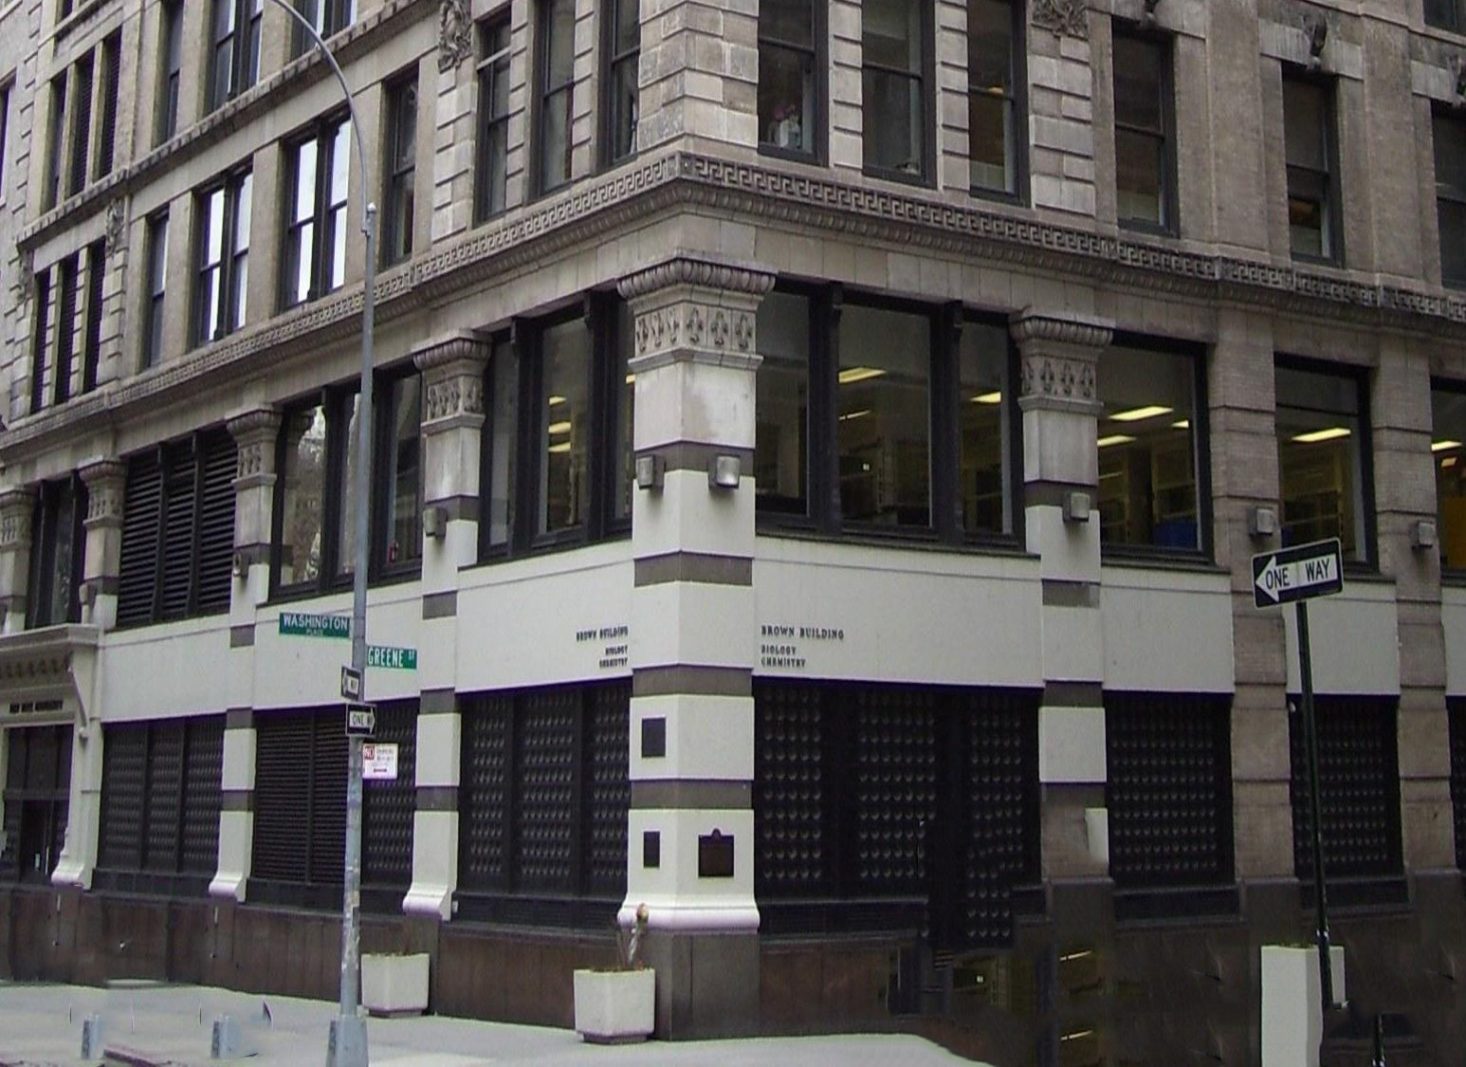
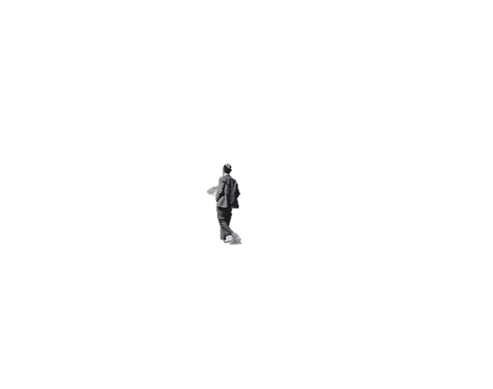
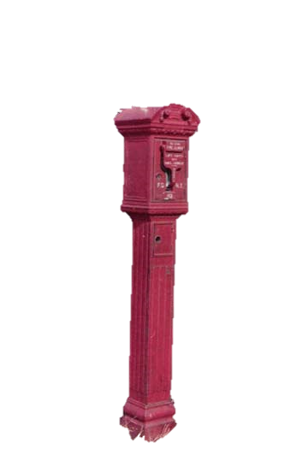
Washington
Greene
Notes:
The first alarm was pulled by a passing bystander who observed smoke on the 8th floor at 4:45PM. “

Slide 13
Notes:
“An employee on the 8th floor was able to give another employee on the 10th floor a call on a telephone to notify them however, no one notified the 9th floor. “

Slide 14

Washington
Greene
Notes:
“The Green Street stairway immediately was engulfed in flames and the only other stairway the Washington Place stairway door was locked in fear of workers stealing merchandise, which left a fire escape and elevator left that could be used for escape. “

Slide 15
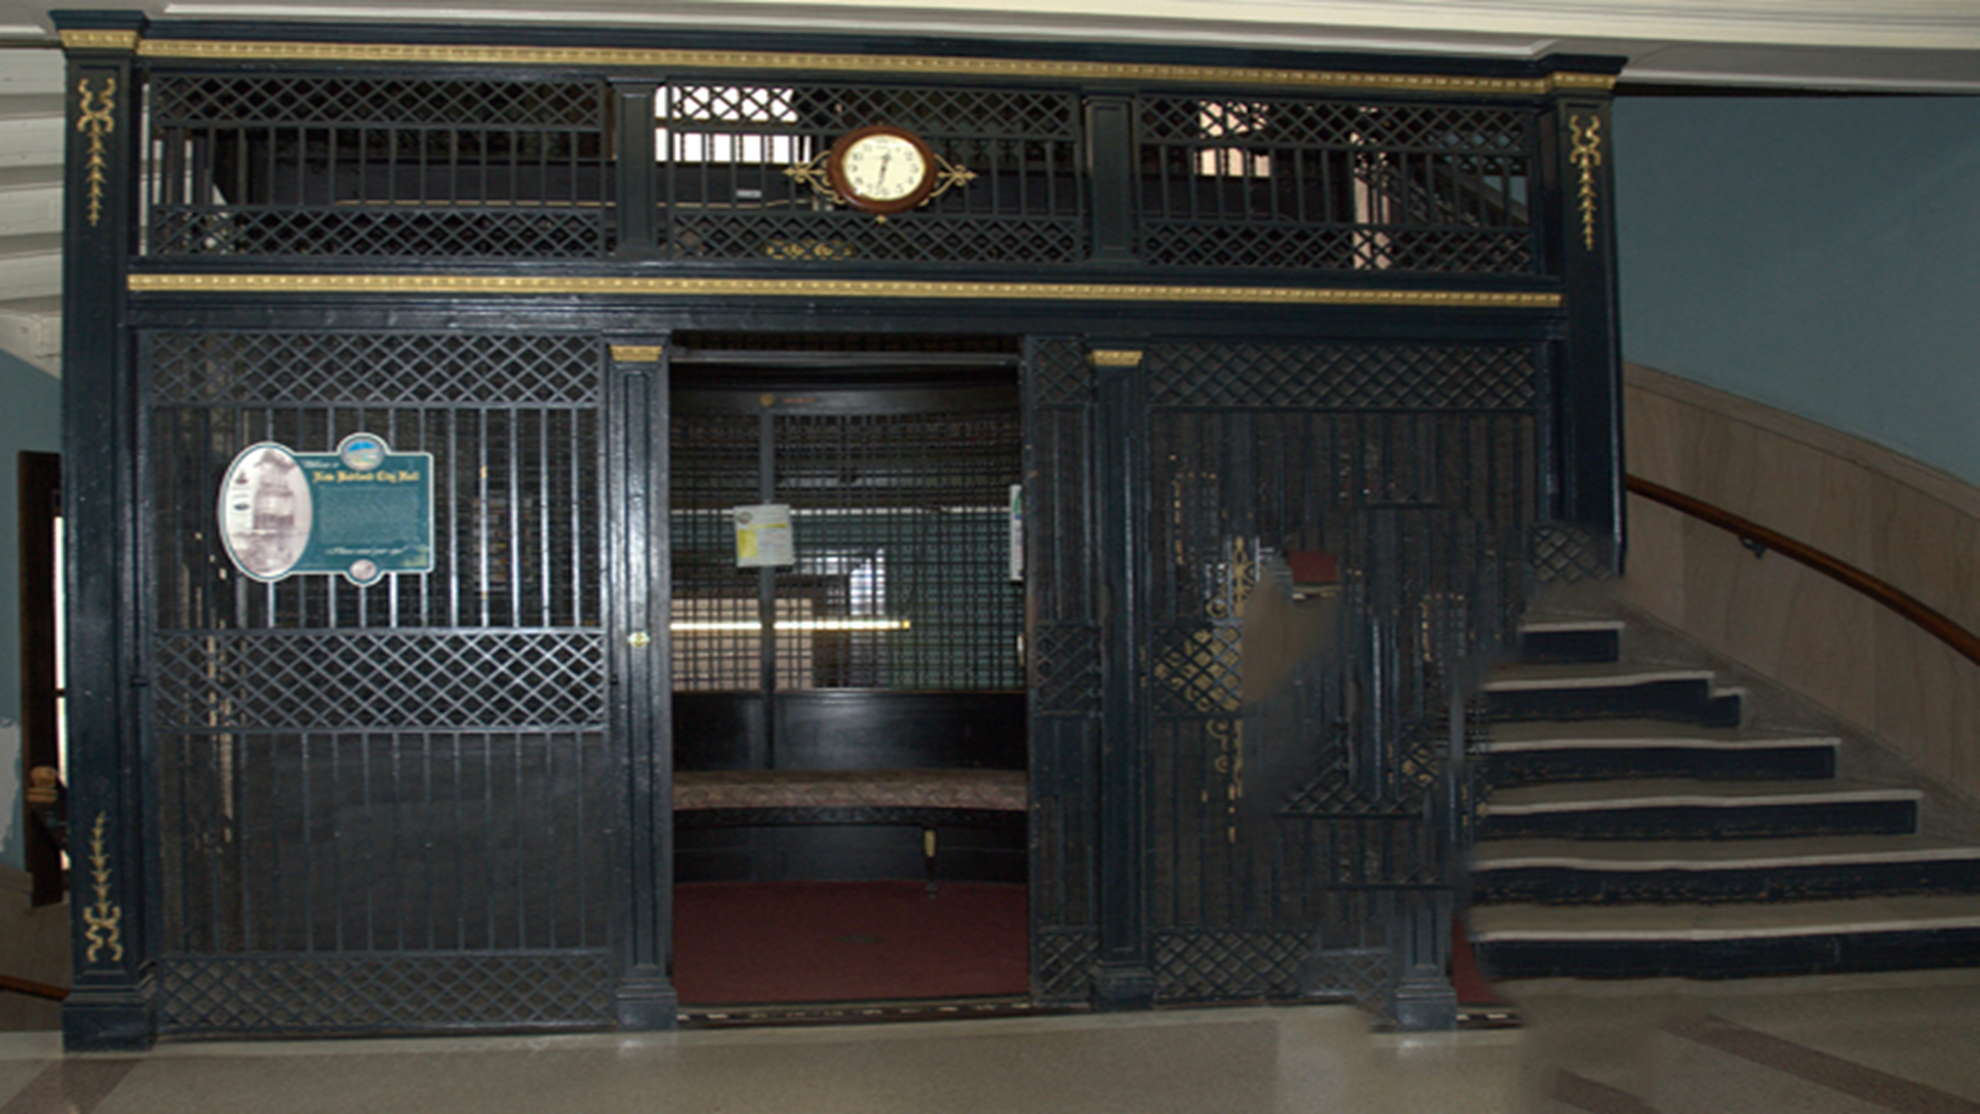
Notes:
“Elevator operators attempted to save as many people as they …”

Slide 16

Notes:
“…however the elevators eventually became not function able due to the extreme heat. “

Slide 17
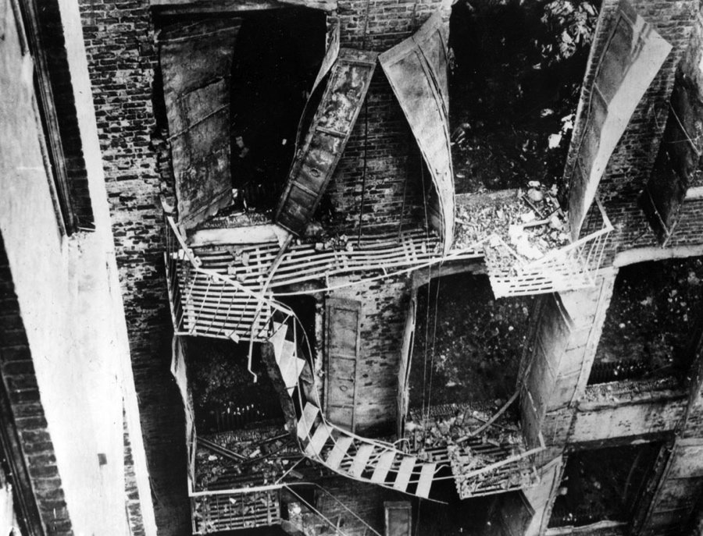
Notes:
“Too many desperate people went onto the fire escape and it collapsed onto the road killing as many as 20 people on impact. “

Slide 18
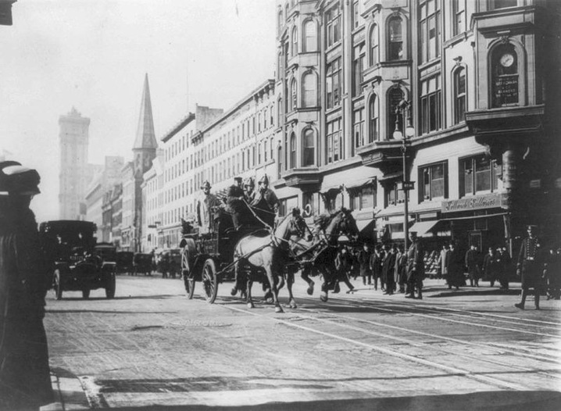
Notes:
“The New York City Fire Department responded almost immediately. ”

Slide 19
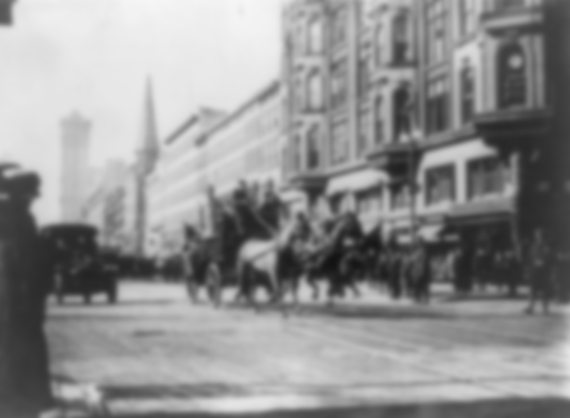
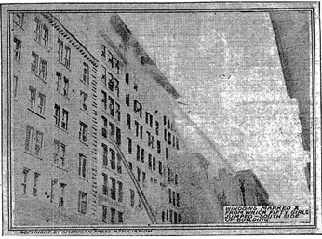
Notes:
“however they did not have tall enough ladders to reach the top of the Asch building or long enough hoses. ”

Slide 20
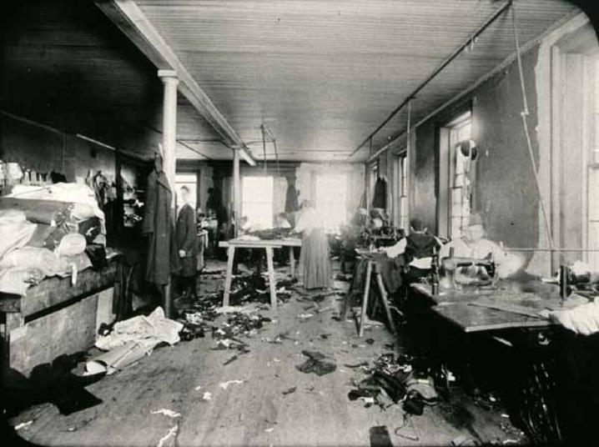
Notes:
“Reports from eyewitnesses say they seen as many as 62 people jump to their deaths. “

Slide 21
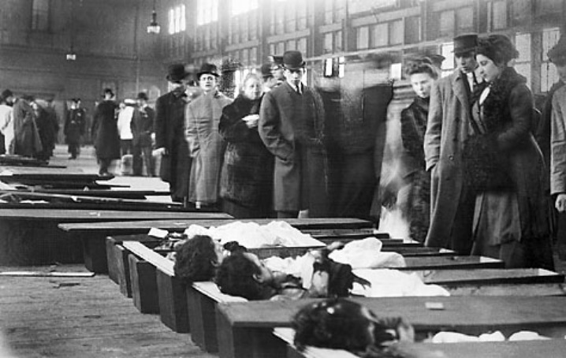
Asphyxiation:
smoke inhalation
Notes:
“In the end 129 women and 17 men died from the fire, a total of 146 people.
Many deaths were from smoke inhalation asphyxiation and those who jumped out the building.”

Slide 22
Social Changes
Notes:
SOCIAL CHANGES
“After the events of the devastating fire, various social changes were put into effect. “

Slide 23
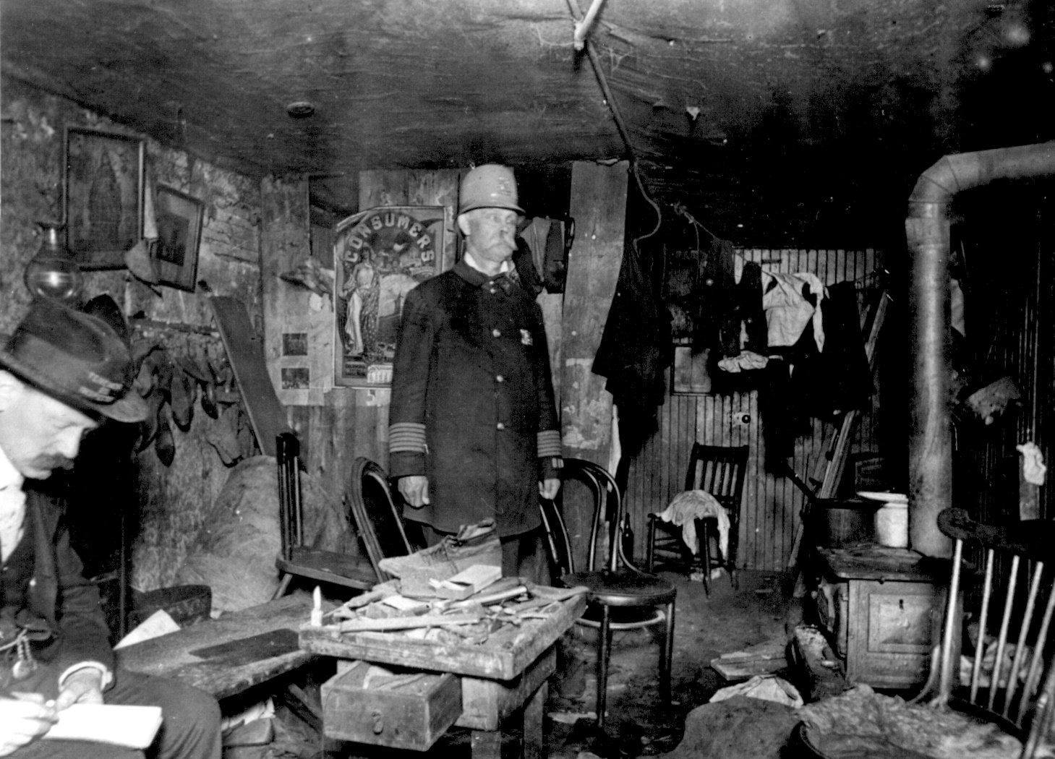
Notes:
“New York City created Bureau of Fire Prevention in October 1911 to carry out inspections and enforce codes. Buildings became required to have building sprinklers above the 7th floor when there are more than 200 people in a room. “

Slide 24
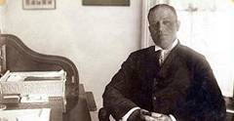
In response to the fire,
retired New York City Fire Chief
Edward F. Croker
reveals how little the owners of the Triangle Factory cared about their employees, saying that the factory’s owners do not care about their employees or hazards in the building. (n.pag.).
Notes:
In response to the fire, retired New York City Fire Chief Edward F. Croker reveals how little the owners of the Triangle Factory cared about their employees, saying that the factory’s owners do not care about their employees or hazards in the building. (n.pag.). In the early industrialization era companies did not care about employee rights nor have any remorse for workers killed. Not until the Triangle Factory Fire were worker unions and federations created.”

Slide 25
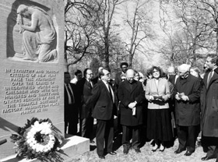
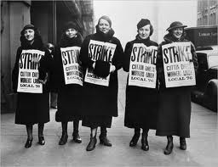
Notes:
“The New York legislature passed 8 bills in 1912 that addressed sanitation, rest periods, child labor, work hours for women and children, and injuries sustained on the job.”

Slide 26


1912 Bills
Notes:
“The New York legislature passed 8 bills in 1912 that addressed sanitation, rest periods, child labor, work hours for women and children, and injuries sustained on the job.”

Slide 27
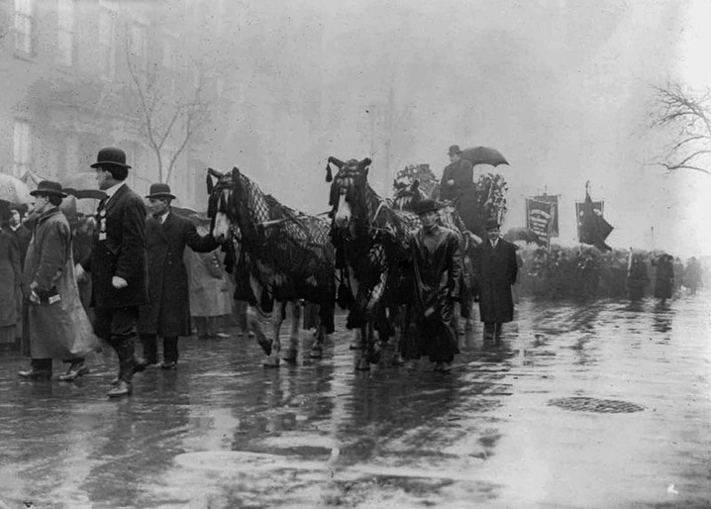
In the early industrialization era companies did not care about employee rights nor have any remorse for workers killed. Not until the Triangle Factory Fire were worker unions and federations created.
Notes:
“In the early industrialization era companies did not care about employee rights nor have any remorse for workers killed. Not until the Triangle Factory Fire were worker unions and federations created.”

Slide 28
Course Theme:
Elitism
&
Egalitarianism
Notes:
Course theme

Slide 29
Contributors:
Victor Lourng
Daniel Yi
Joshua Sirken
Notes:
Course theme

Slide 30
The End

